Slide 1
Open invitation to collaborate on an open source NR toolset VQEG Glasgow September 2015
Philip Corriveau Principal Engineer Intel Corporation

Slide 2
Industry / Academia / Government ….
We do what we do for the everyday users..
Continue switching gears…

Slide 3
No-Reference Quality Assessment
Consumer generated content growing exponentially; Critical need for no-reference quality assessment methods
Opportunity for VQEG to lead and drive holistic innovation through NR metrics and tool set development
Open and iterative approaches are transforming the pace and impact of research & development
Open collaborative ways are critical to move the NR QA research forward in:
Subjective methodologies
Objective Algorithms
Tool implementations of the above two.
VQEG’s VIME project is a prime example of moving with velocity
Record time in creation
Unification around a very difficult problem
Large interest and participation; Excellent Progress in metric development through regular meetings, group initiatives, algorithm discussions, and reference tools

Slide 4
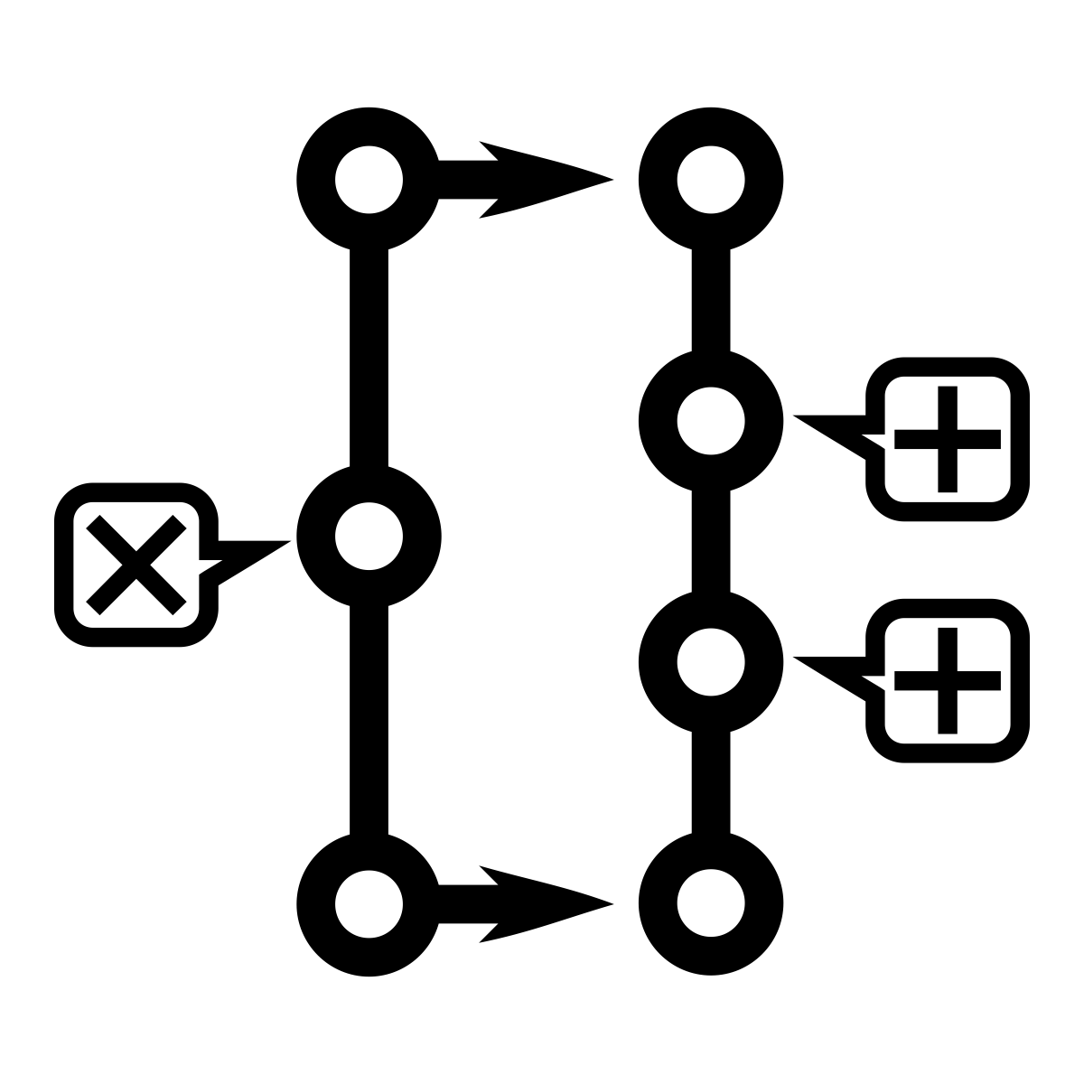
VIME IQA Toolset
VIME Open Source framework for transparent and collaborative development
Preview Releases to drive broader ecosystem participation and faster feedback
Open Source
Velocity
Increase VQEG impact and relevance by building VIME tool set through open and iterative development processes
Notes:
to drive investigation, collaboration, refinement and more importantly evolution of the tools to best serve the Industry and the consumers.

Slide 5
VIME IQA Toolset
Proposed timeline of activities
VIME IQA Toolset
Preview Release to get community feedback.
Q4 2015
Formation of VIME 2014
IQA Reference Tool Feb 2015
VIME Open Source Framework
Q3 2015
1
2
3
4
5
6
7
8
VIME Consumer-centric approach
Image categories to bound IQA problem space
Jan 2015
Refine and Iterate
Extend and improve Algo/Toolset through feedback, collaborative development and larger data sets; Consumer-friendly mobile apps.
Future
VIME Image Database
Q1 2015
IQA Open source contributions
Q3 – Q4 2015
Today
Notes:
This release is based on algorithms described in IEEE paper xyz
> - Aligns uniquely with non lab testing but a consumer centric real world evaluation discussed all along in the VIME meetings

Slide 6
Offering VIQET
VIME Image Quality Evaluation Tool-kit
Open Source
Publications
M.A. Saad, P. Corriveau, R. Jaladi, “Objective Consumer Device Photo Quality Evaluation”, IEEE Signal Processing Letters, Vol. 22, No. 10, pp 1516-1520, February, 2015.
M.A. Saad, P. Corriveau, R. Jaladi, “Consumer Content Framework for Blind Photo Quality Evaluation”, 9th Int’l Workshop on Video Processing and Quality Metrics for Consumer Electronics (VPQM), February, 2015
M.A. Saad, P. Corriveau, R. Jaladi, “Revealing the Dark Side of a Subjective Study: Learnings from Noise and Sharpness Ratings”, 7th Int’l Workshop on the Quality of Multimedia Experience (QoMEX), May, 2015.
M.A. Saad, P. Le Callet, P. Corriveau, “Blind Image Quality Assessment: Unanswered Questions and Future Directions in the Light of Consumer Needs”, VQEG eLetter, vo. 1, no. 2, pp. 62-66, 2014.
M.A. Saad, M.H. Pinson, D.G. Nicholas, N. Van Kets, G. Van Wallendael, R. Da Silva, R.V. Jaladi, and P.J. Corriveau, “Impact of Camera Pixel Count and Monitor Resolution on Perceptual Image Quality”, IEEE Color and Visual Computing Symposium (CVCS), August 2015.
Community Preview Releases of Desktop App and Mobile implementations
Notes:
to drive investigation, collaboration, refinement and more importantly evolution of the tools to best serve the Industry and the consumers.

Slide 7
Questions & Answers

